Slide 1
Applied Machine Learning SEZG568/SSZG568
Dr Y V K RAVI KUMAR
yvk.ravikumar@pilani.bits-pilani.ac.in

Slide 2
Session 5(25th August,2023)
(Friday)

Slide 3
4 | Linear Prediction Models: Linear Regression, Gradient Descent and Variants, Regularization, Bias Vs. Variance | T1: Chapter 4

Slide 4
Regression

Slide 5
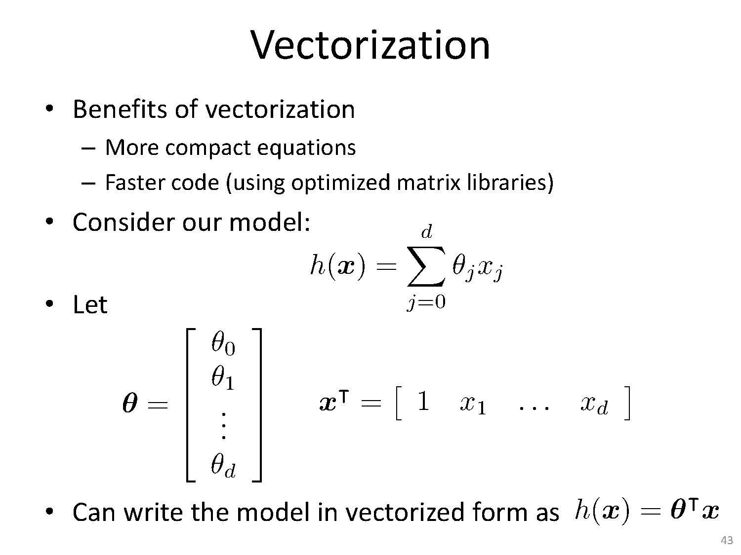
Least Squares Based Solution

Slide 6
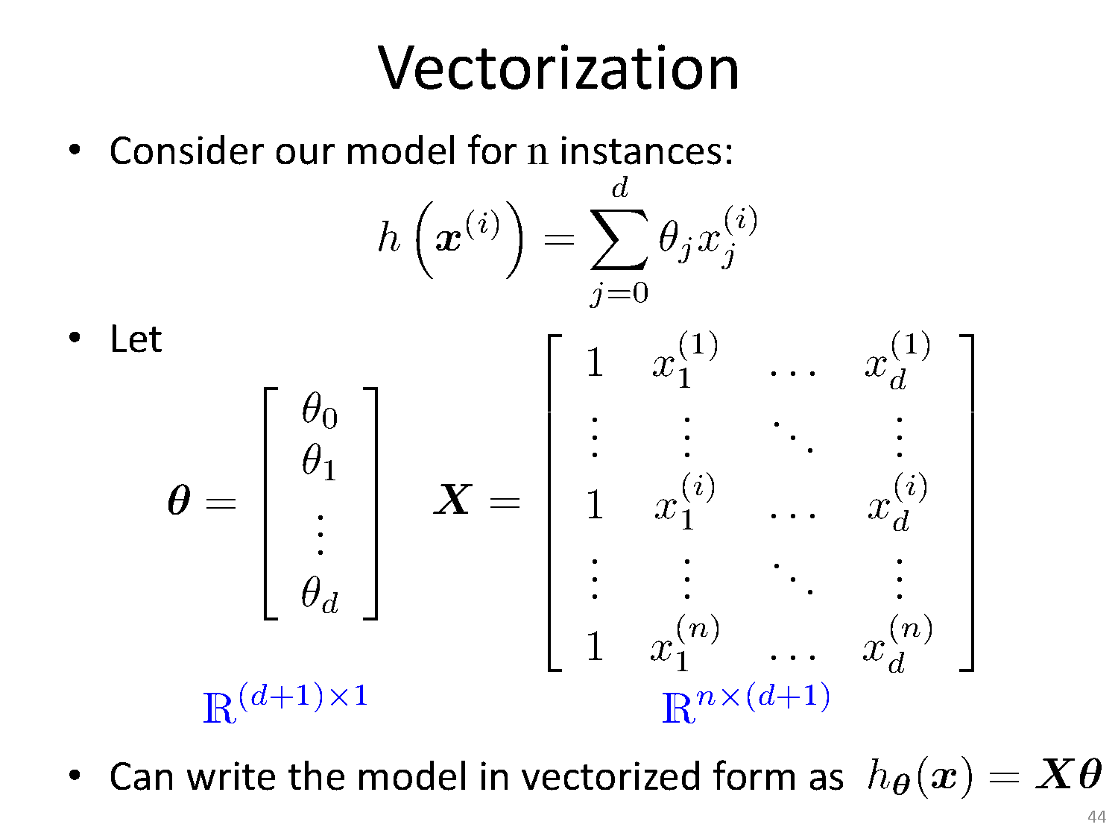
Least Squares Based Solution

Slide 7
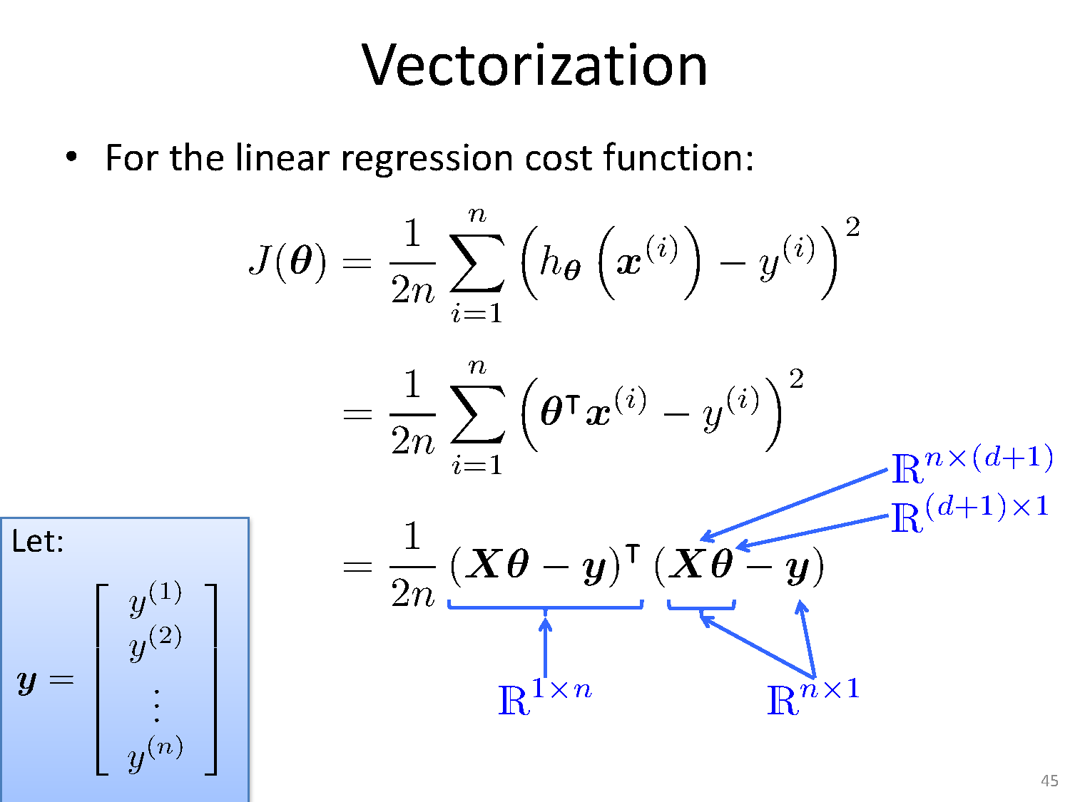
Least Squares Based Solution

Slide 8
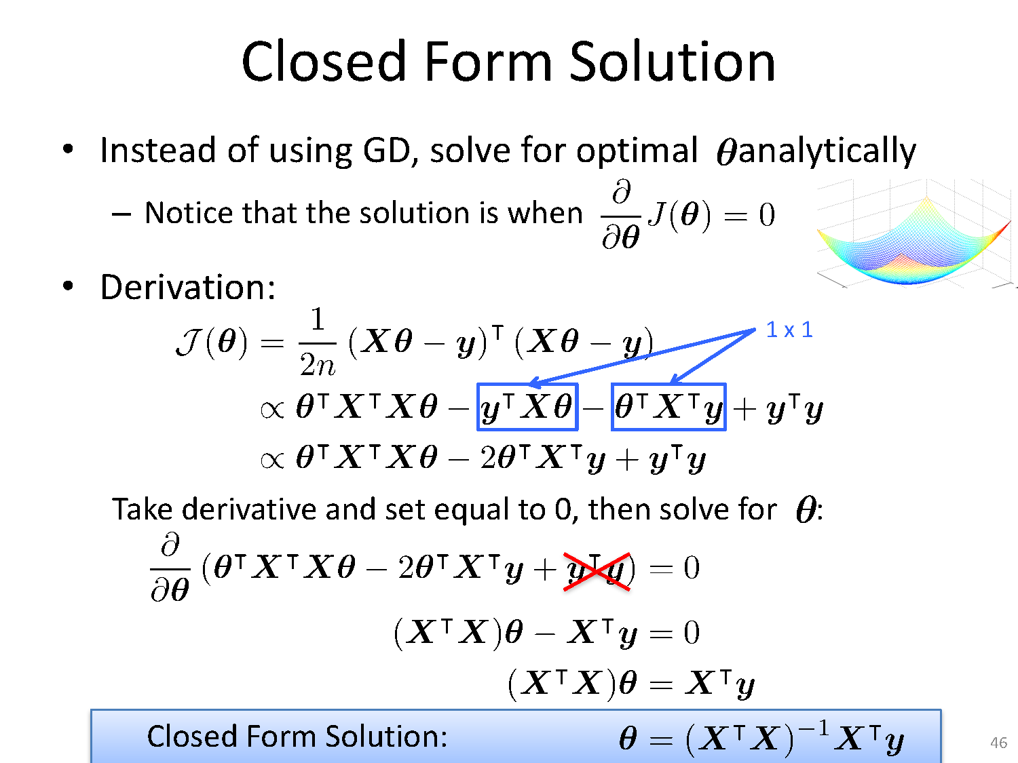
Least Squares Based Solution
Solve for optimal θ analytically

Slide 9
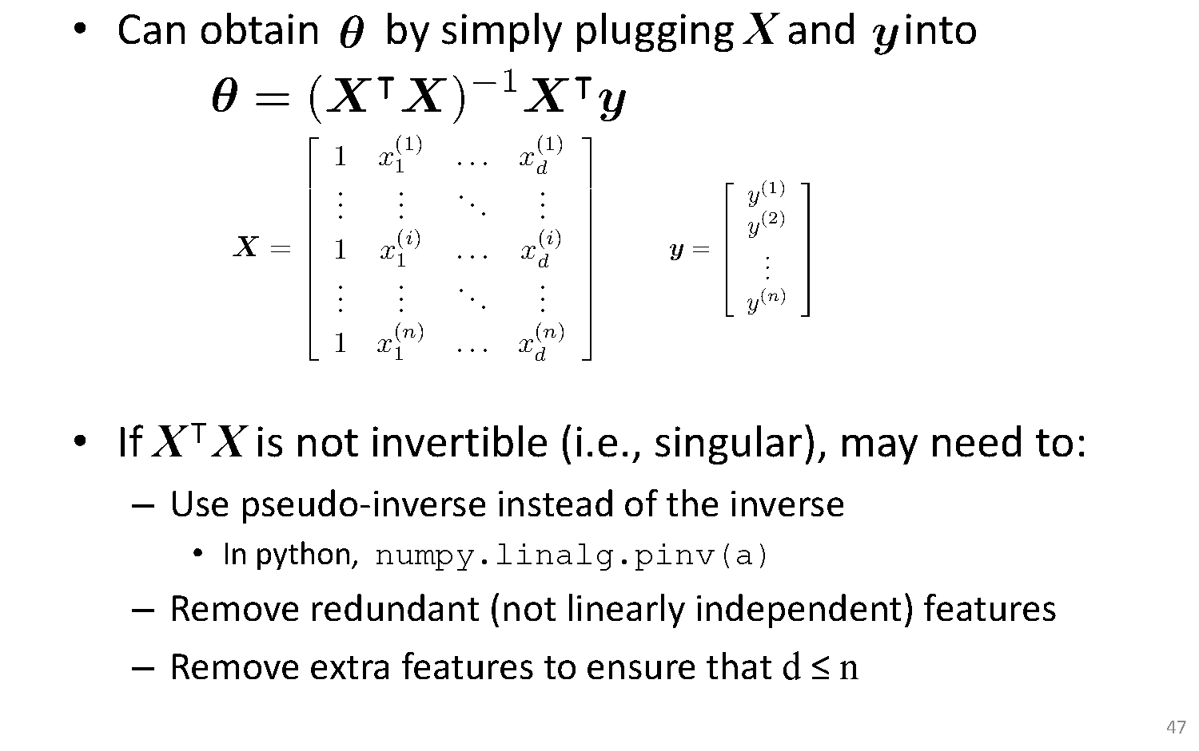
Least Squares Based Solution

Slide 10
Linear regression

Slide 11
Linear regression

Slide 12
Linear regression

Slide 14
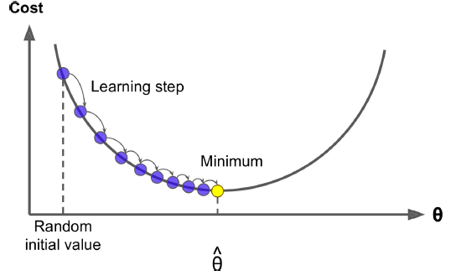
Gradient Descent
Gradient Descent is a very generic optimization algorithm capable of finding optimal solutions to a wide range of problems.
The general idea of Gradient Descent is to tweak parameters iteratively in order to minimize a cost function.
Concretely, you start by filling θ with random values (this is called random initialization), and then you improve it gradually, taking one baby step at a time, each step attempting to decrease the cost function (e.g., the MSE), until the algorithm converges to a minimum

Slide 15
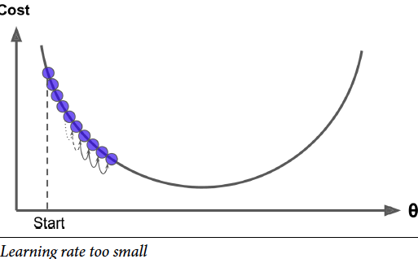
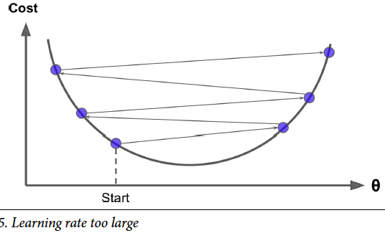
Gradient Descent- Hyper parameter
On the other hand, if the learning rate is too high, you might jump across the valley and end up on the other side, possibly even higher up than you were before. This might make the algorithm diverge, with larger and larger values, failing to find a good solution
If the learning rate is too small, then the algorithm
will have to go through many iterations to converge, which will take a long time

Slide 16
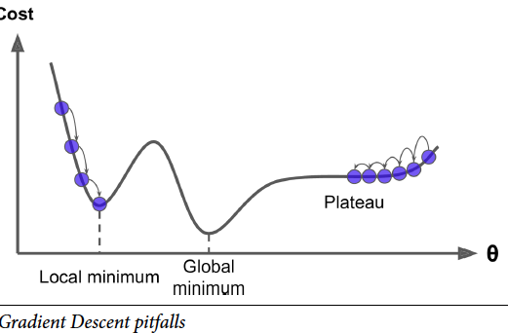
Gradient Descent- Pitfalls
Finally, not all cost functions look like nice regular bowls.
There may be holes, ridges,plateaus, and all sorts of irregular terrains, making convergence to the minimum very difficult.
Figure shows the two main challenges with Gradient Descent:
if the random initialization starts the algorithm on the left, then it will converge to a local minimum , which is not as good as the global minimum.
If it starts on the right, then it will take a very long time to cross the plateau, and if you stop too early you will never reach the global minimum.

Slide 17
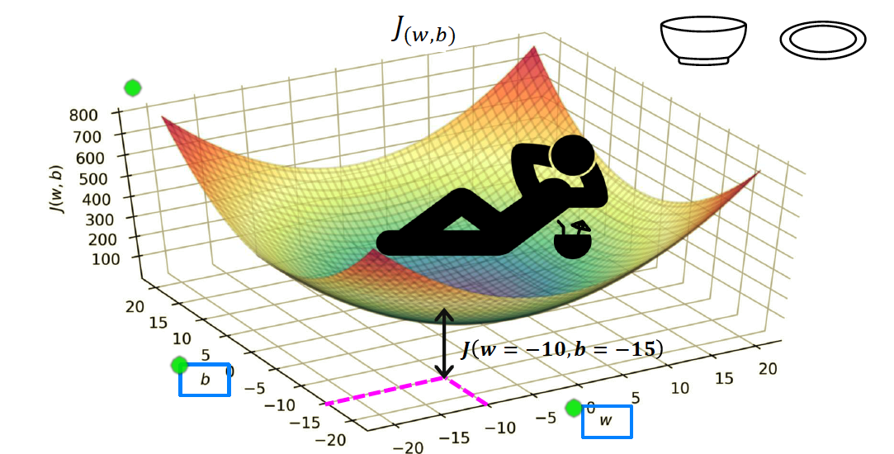
Intuition Behind Cost Function

Slide 18
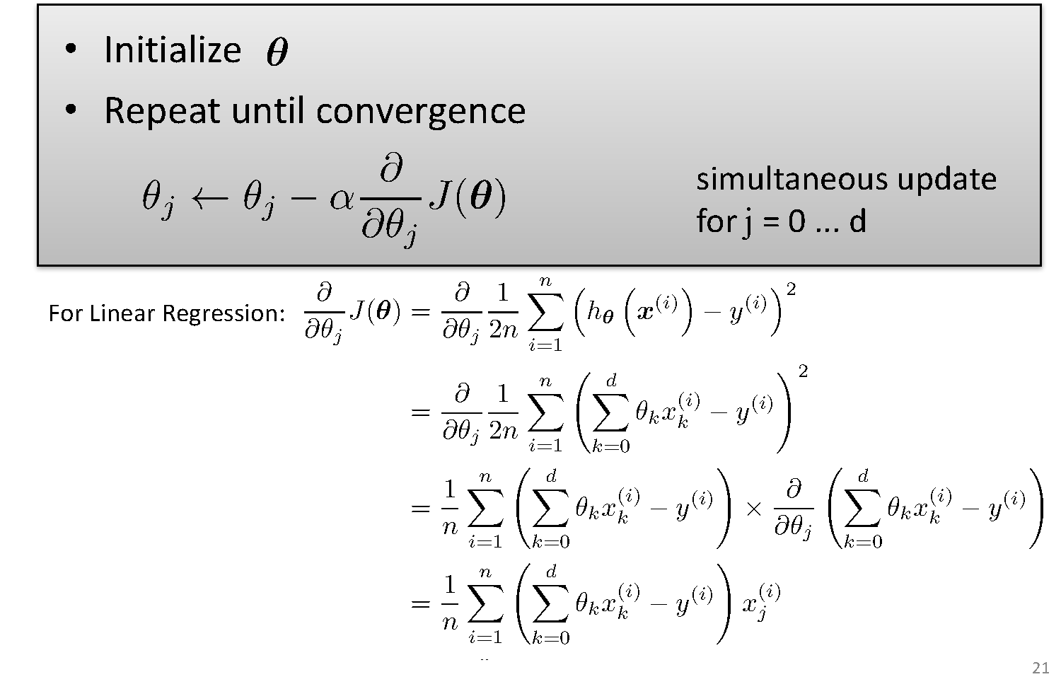
Gradient Descent

Slide 19
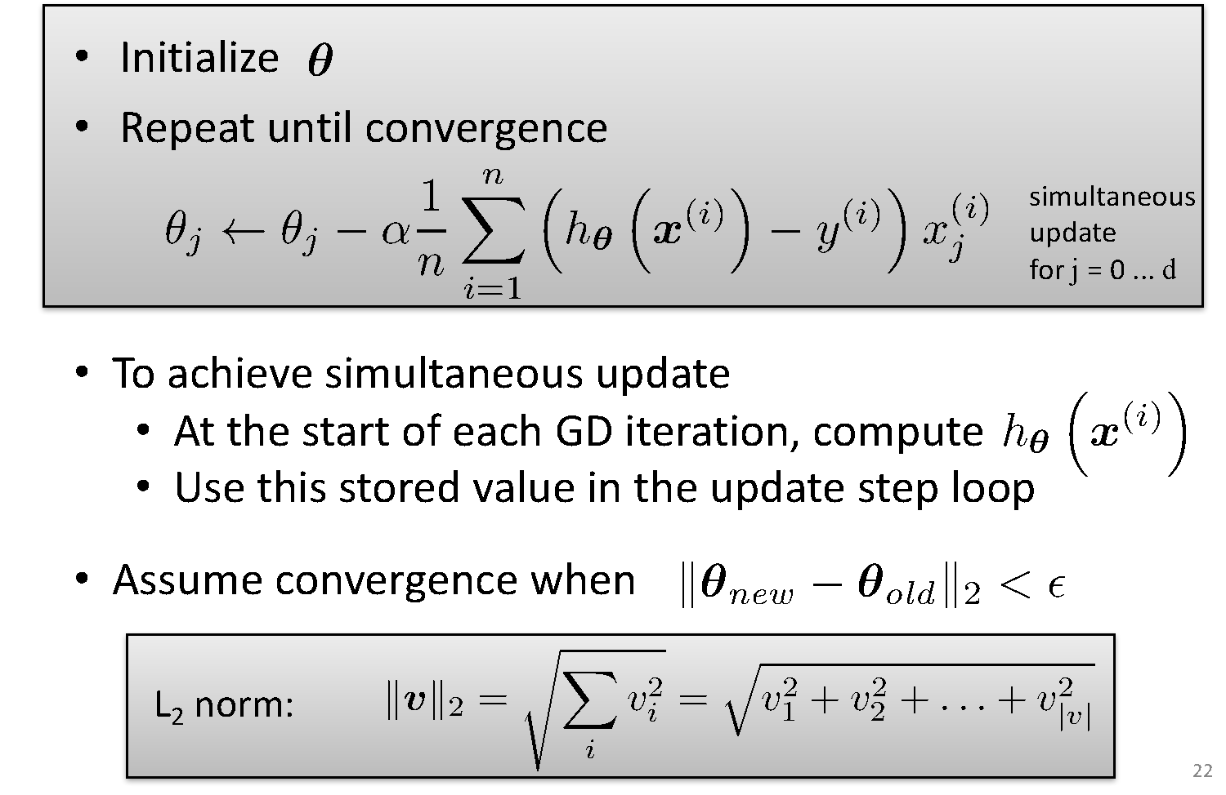
Gradient Descent for Linear Regression

Slide 24
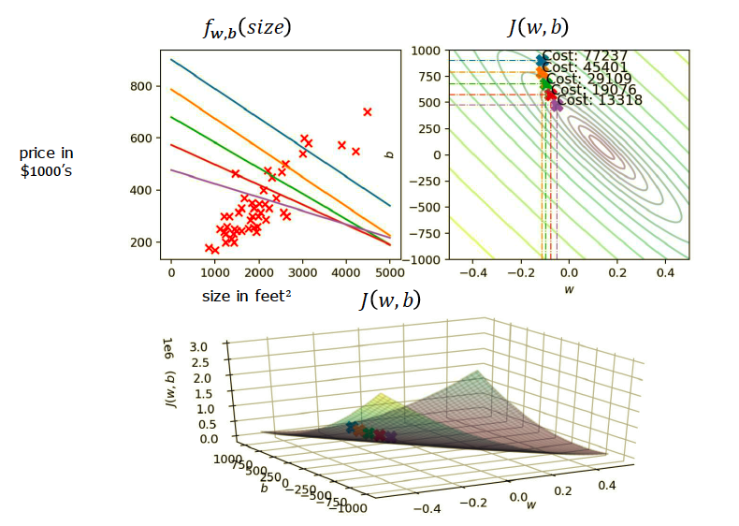
Running Gradient Descent

Slide 25
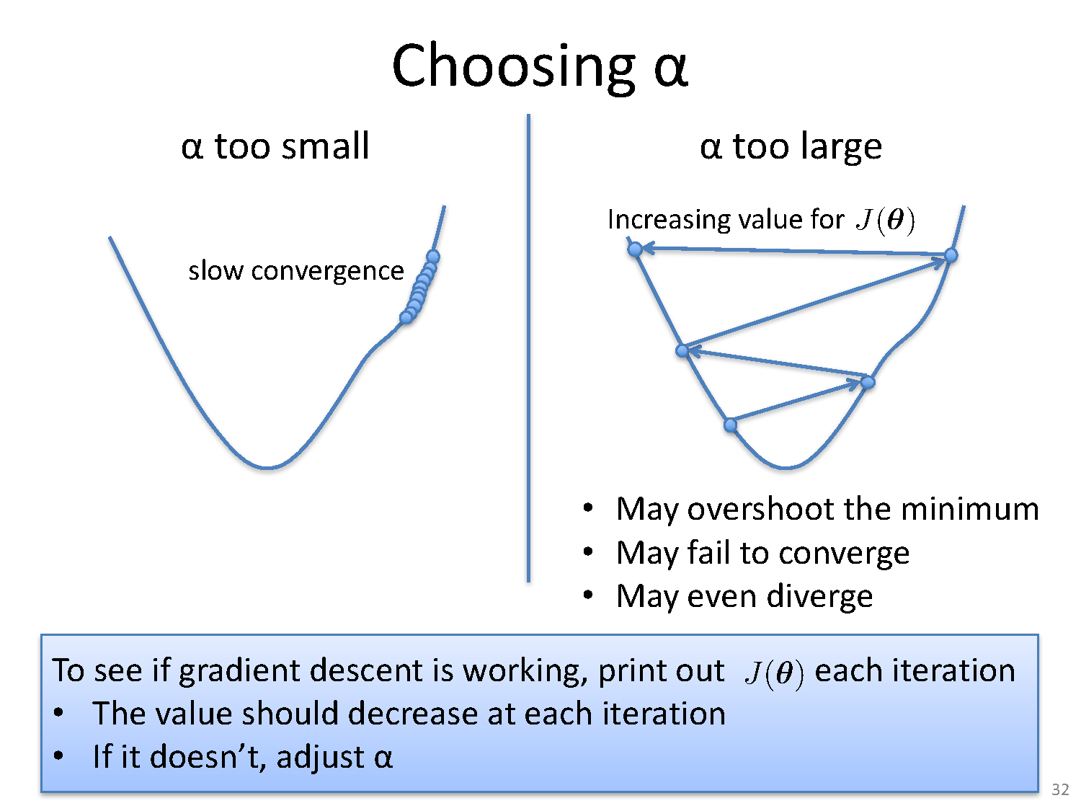
Choosing Step Size

Slide 26
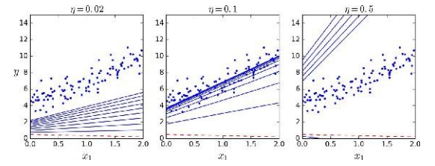
Impact of Learning Rate
α=0.02
α=0.02
α=0.1
α=0.5

Slide 27
Mini-batch Gradient Descent Algorithm

Slide 28
SGD
GD can be very slow on large datasets
So in such case SGD can be used
In SGD, the procedure is same as GD but the difference is updatation of coefficients is done for each training example rather than at the end of training
i. e. cost is not summed over all training examples , but instead for one training example

Slide 29
Stochastic Gradient Descent Algorithm

Slide 30
Mini Batch Stochastic Gradient Descent Algorithm(MBSGD)

Slide 34
Summary
Optimization is a big part of machine learning.
Gradient descent is a simple optimization procedure that you can use with many machine learning algorithms.
Batch gradient descent refers to calculating the derivative from all training data before calculating an update.
Minibatch refers to calculating derivative of mini groups of training data before calculating an update.
Stochastic gradient descent refers to calculating the derivative from each training data instance and calculating the update immediately

Slide 35
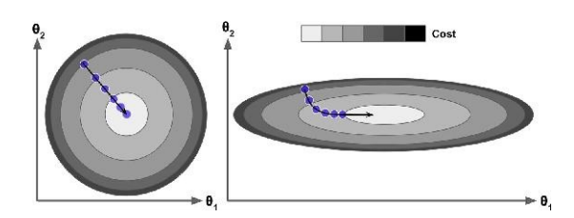
Feature Normalization
Gradient Descent can be slow when feature scales are widely different
Normalization of feature values for same variance needed for faster convergence

Slide 36
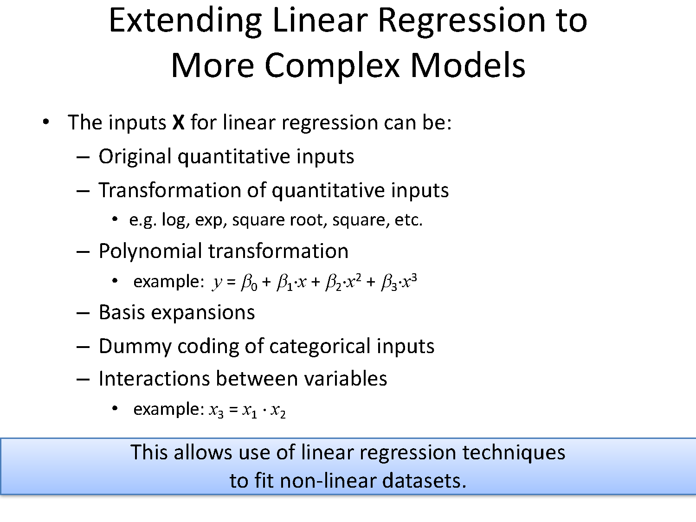
Extending to More Complex Model

Slide 37
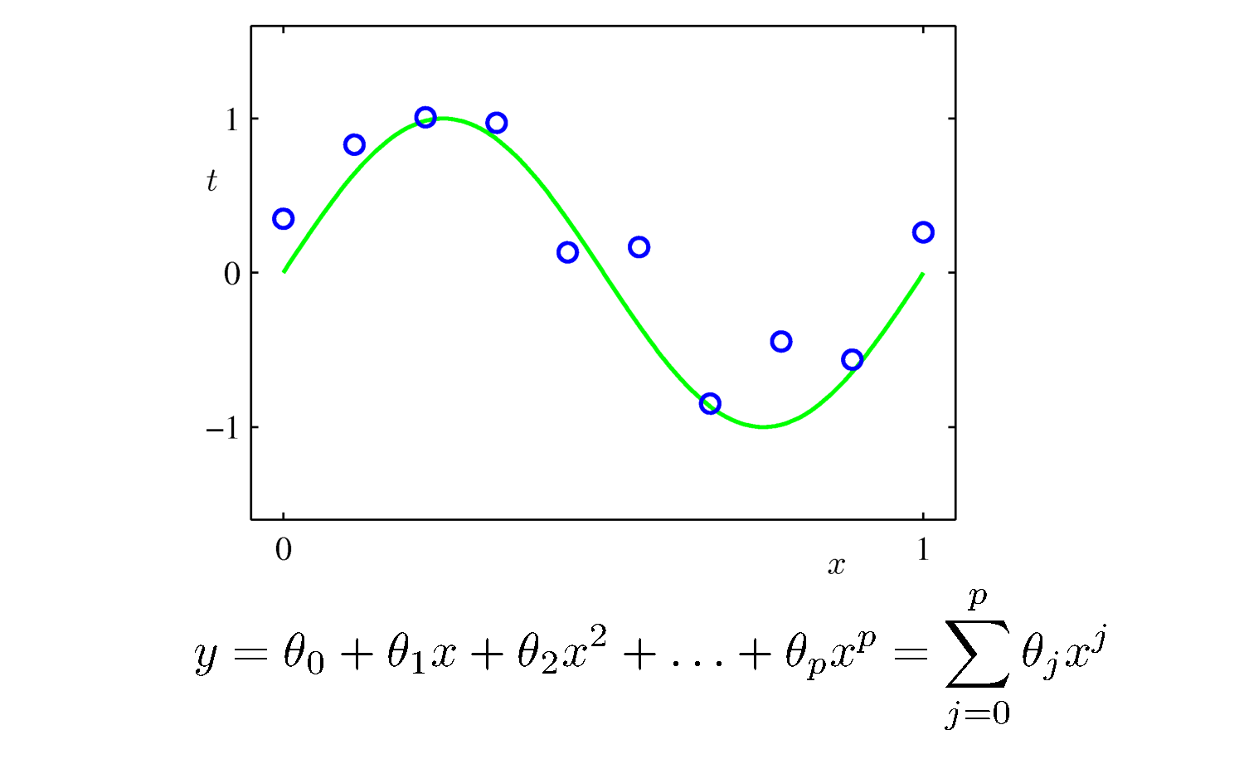
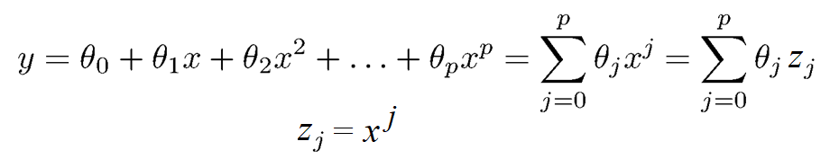
Fitting a Polynomial Curve

Slide 38
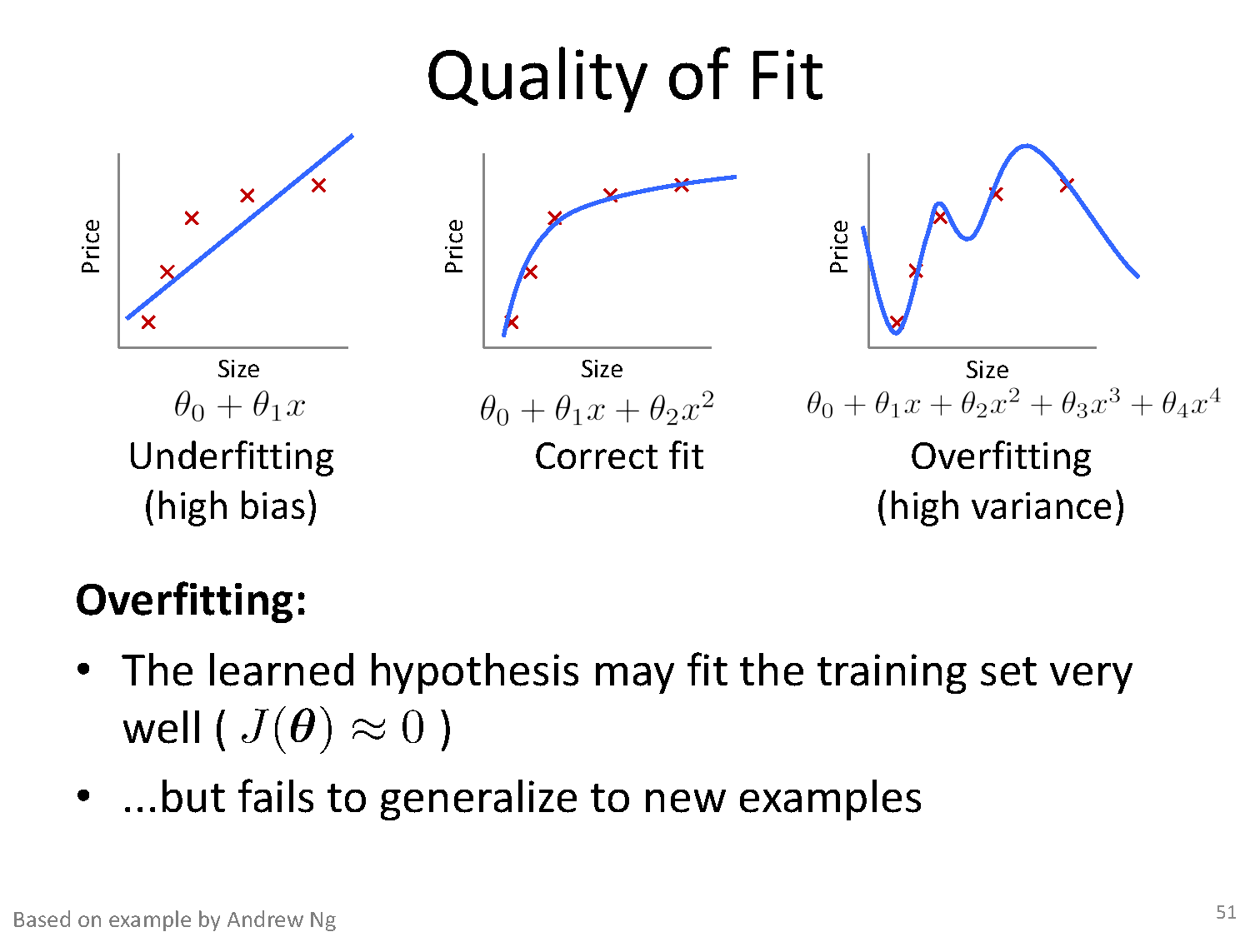
Quality of Fit

Slide 39
Addressing overfitting
$x_{1}=$ size of house
$x_{2}=$ no. of bedrooms
$x_{3}=$ no. of floors
$x_{4}=$age of house
$x_{5}=$average income in neighborhood
$x_{6}=$ kitchen size
$⋮$
$x_{100}$
Price ($) in 1000’s
Size in feet^2

Slide 40
Addressing overfitting
Reduce number of features.
Manually select which features to keep.
Model selection algorithm
Regularization.
Keep all the features, but reduce magnitude/values of parameters $θ_{j}$.
Works well when we have a lot of features, each/many of which contributes a bit to predicting $y$.

Slide 41
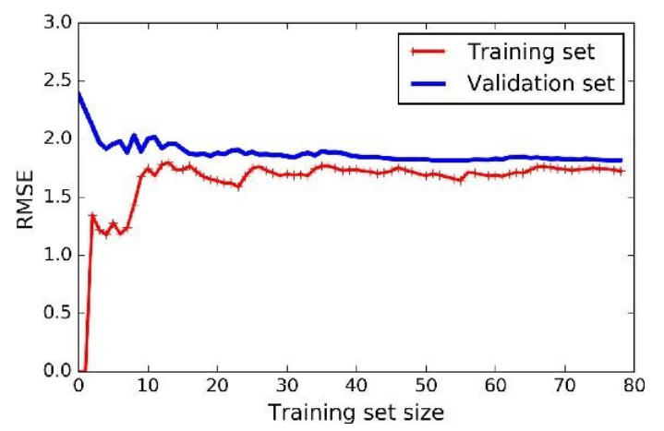
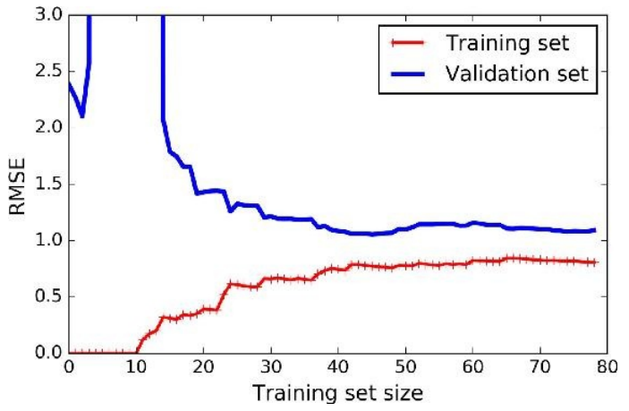
Effect of Training Size on Overfitting
Size of training dataset needs to be large to prevent overfitting
when higher order model is used.
Higher order model
Lower order model

Slide 42
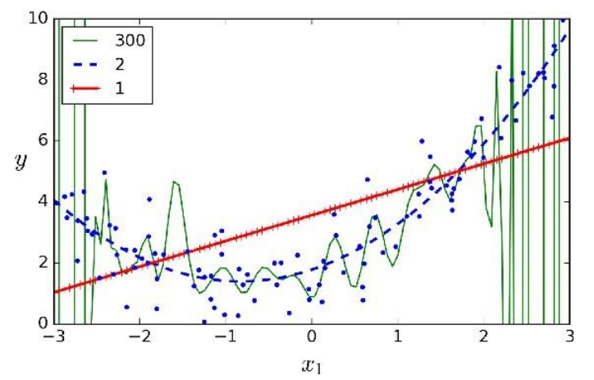
Polynomial Fitting can lead to Overfitting
Underlying target function is quadratic
Linear model results in under fitting with large bias
Polynomial of order 300 results in a large variance

Slide 43
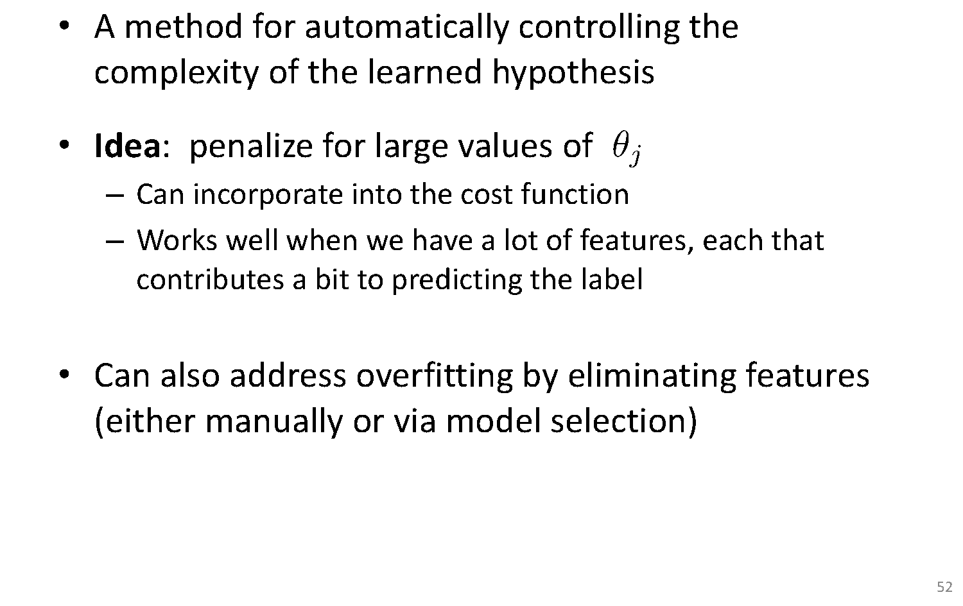
Regularization

Slide 44
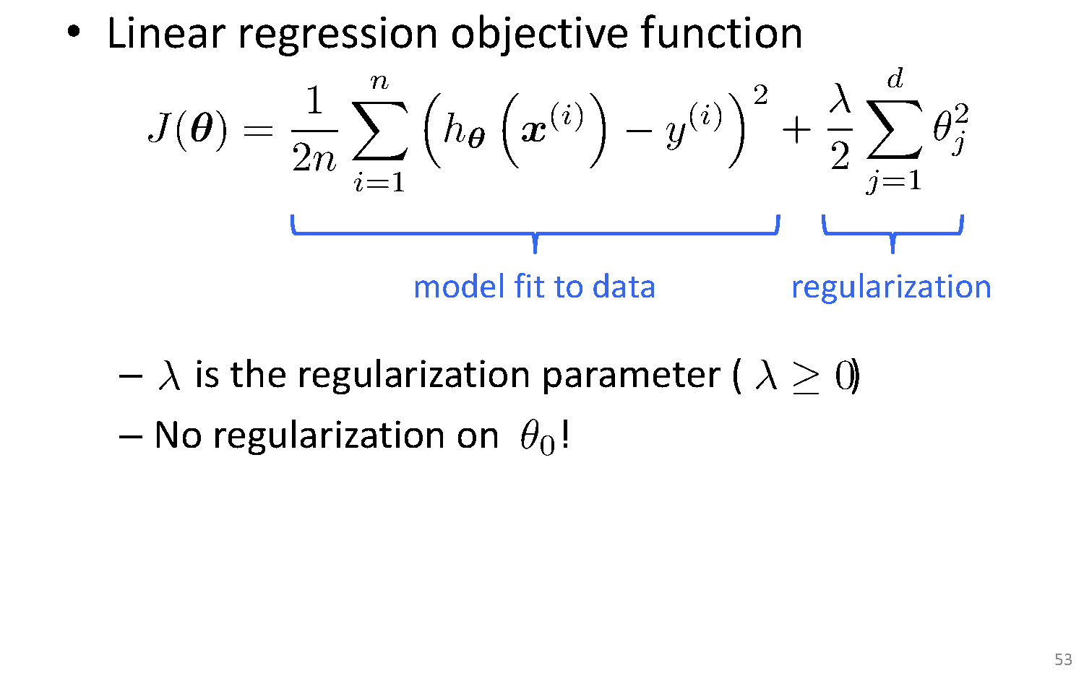
Ridge Regularization

Slide 45
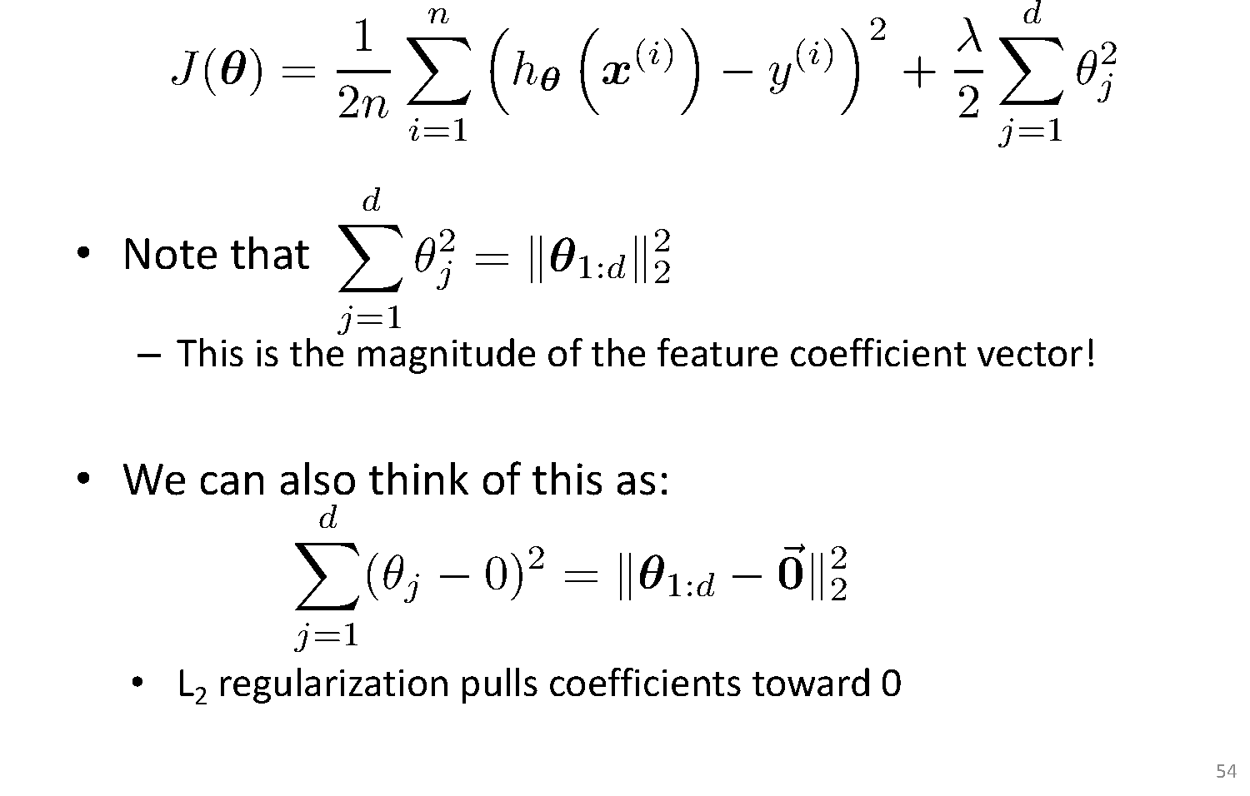
Understanding Regularization

Slide 46
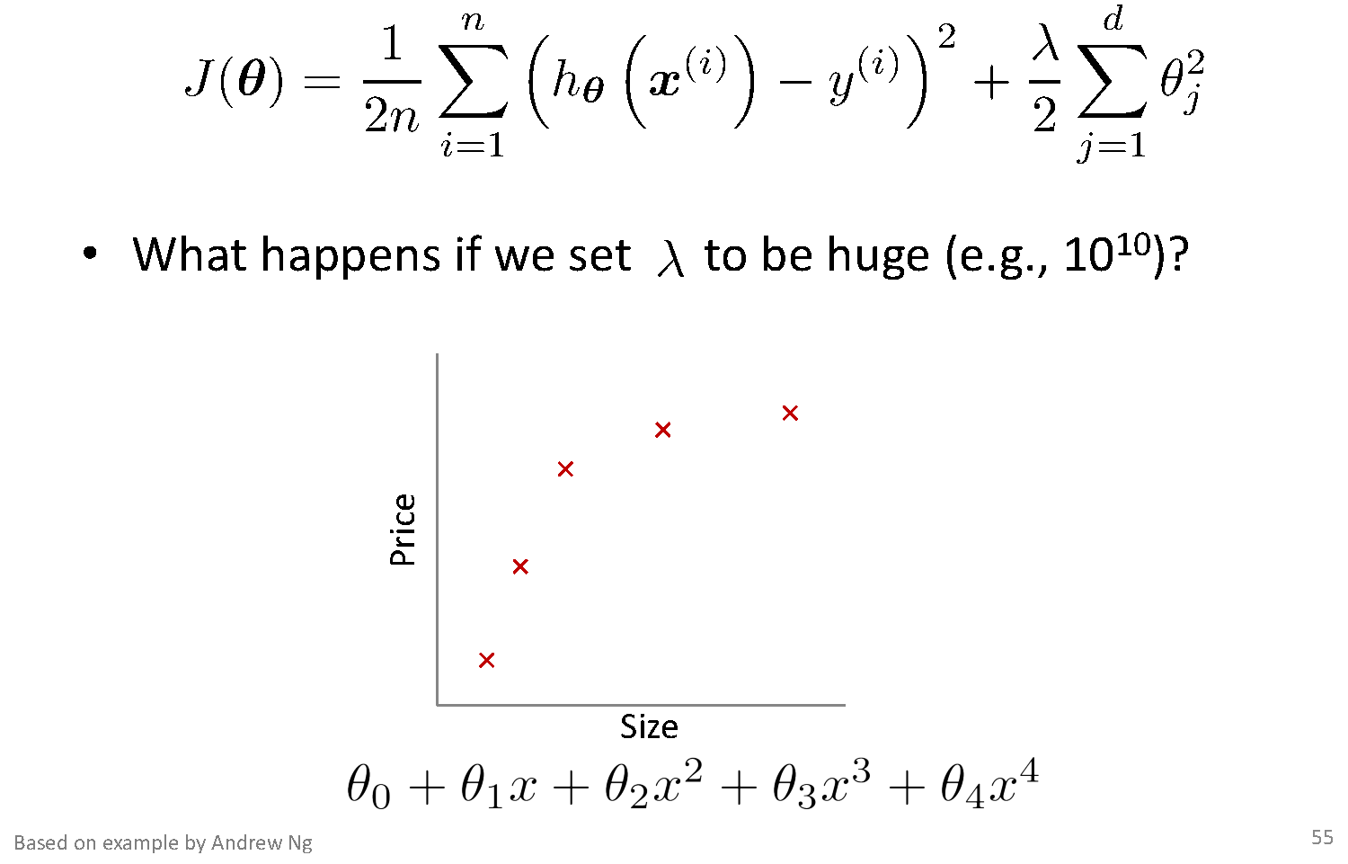
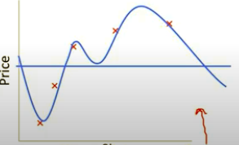
Understanding Regularization
Overfitting

Slide 47
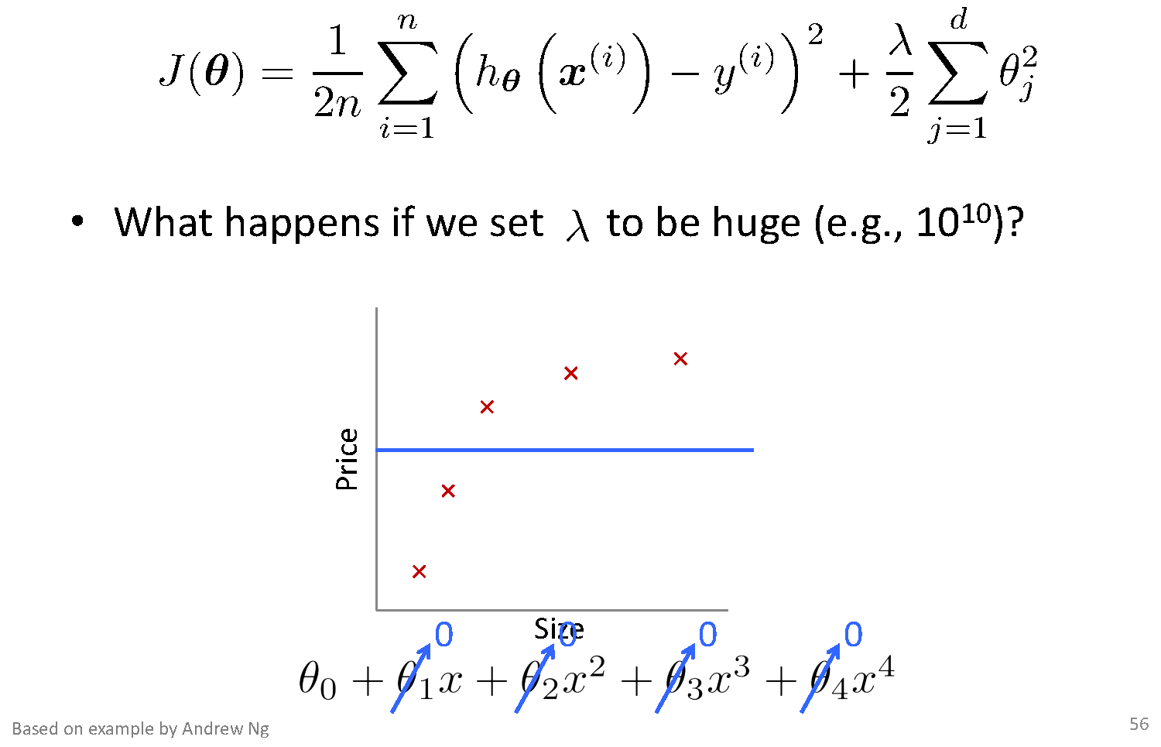
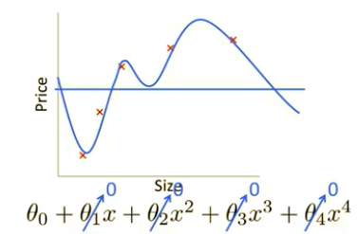
Understanding Regularization
Underfitting

Slide 48
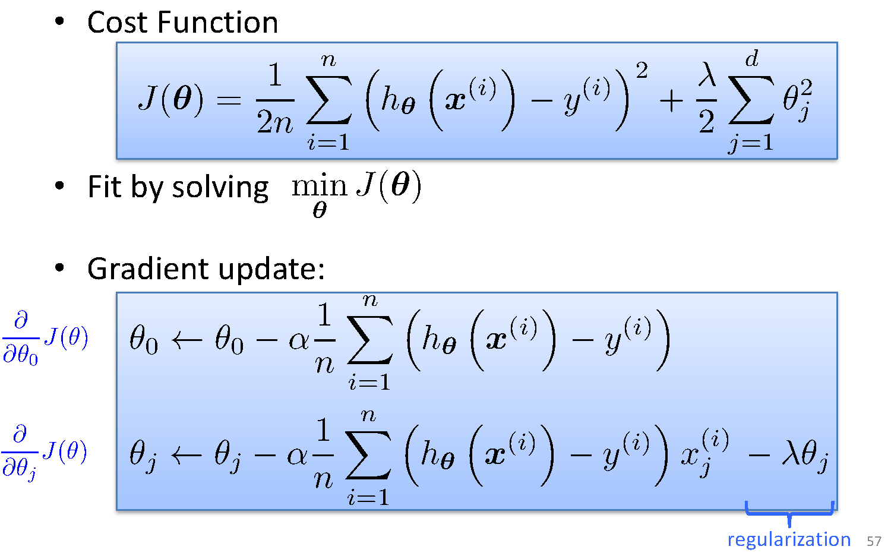
Ridge regression
Regularized Linear Regression

Slide 49
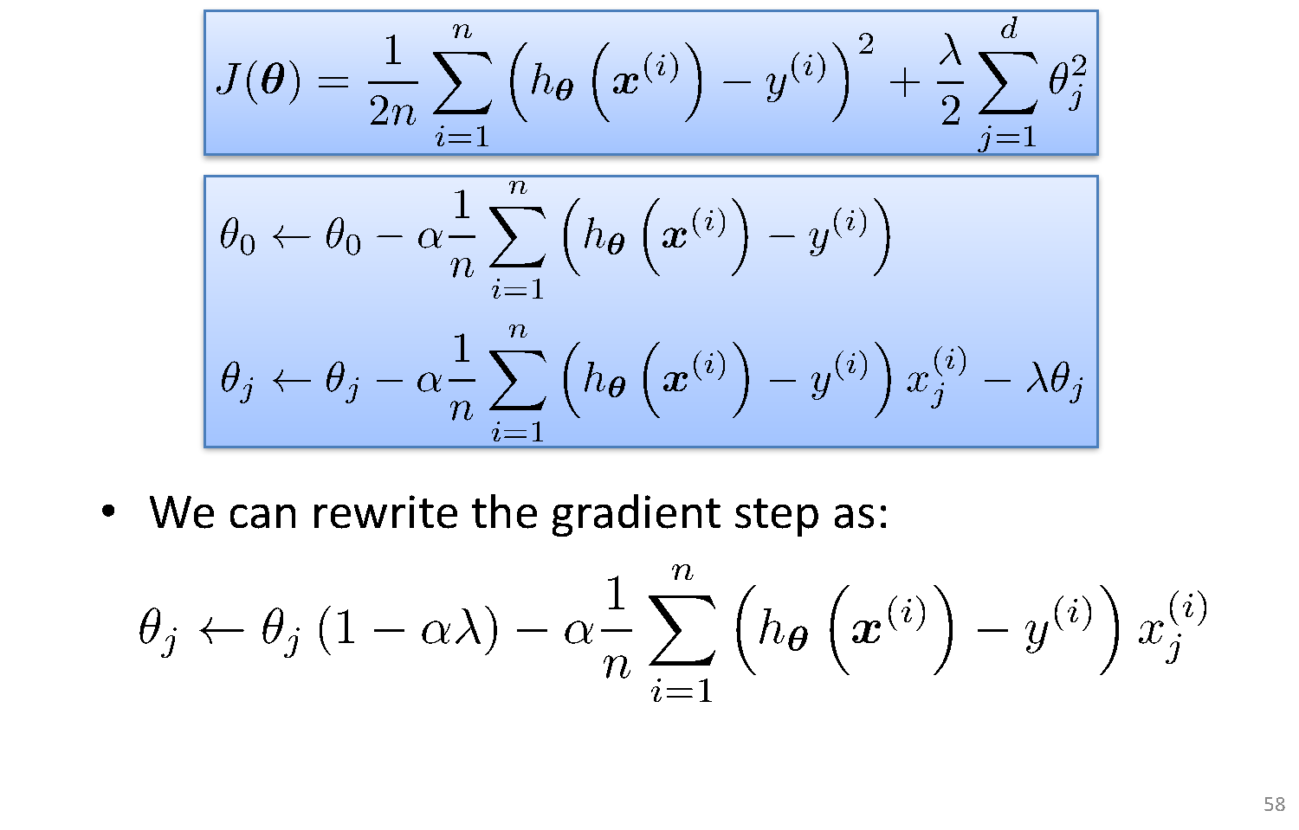
Ridge Regression
Further simplified

Slide 50
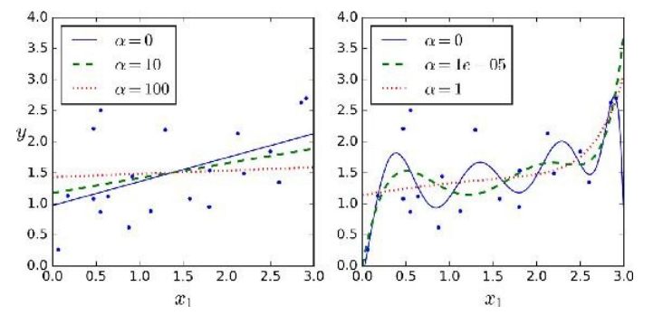
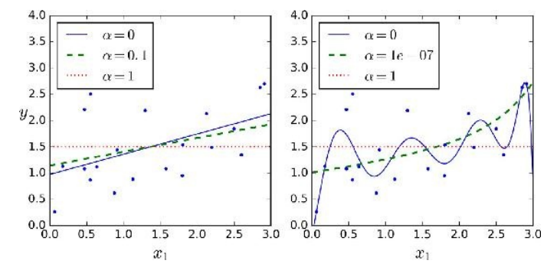
Ridge Vs Lasso Regularization
λ = 0
λ = 0
λ = 10
λ = 10⁻⁵
λ = 100
λ = 1
Lasso
λ = 0
λ = 0
λ = 0.1
λ = 10⁻⁷
λ = 1
λ = 1
λ
Ridge

Slide 51
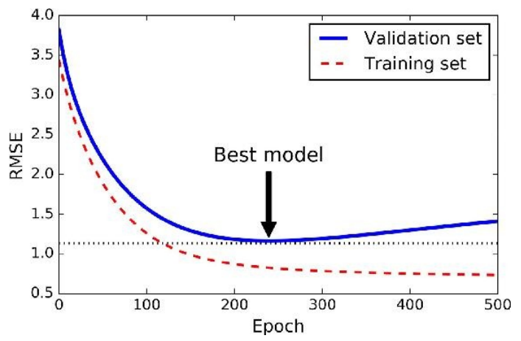
Early Stopping
Do Not Over train to prevent overfitting
Stop training once error on the validation set starts showing an upward trend, even if the error on the training set keeps decreasing

Slide 52
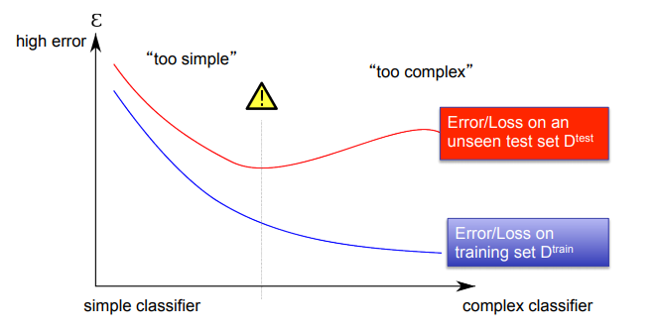
Bias Variance Tradeoff
Bias/Variance is a Way to Understand Overfitting and Underfitting

Slide 53
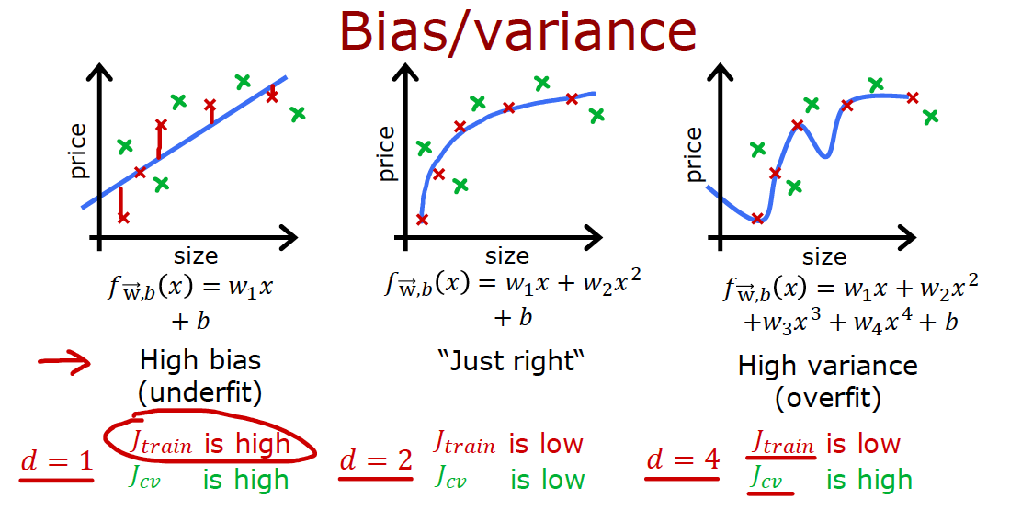
Bias and Variance

Slide 54
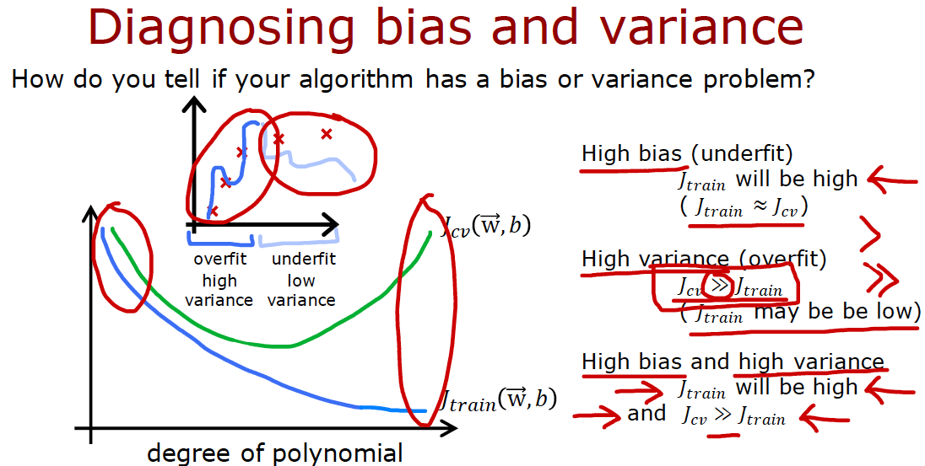
Bias and Variance

Slide 55
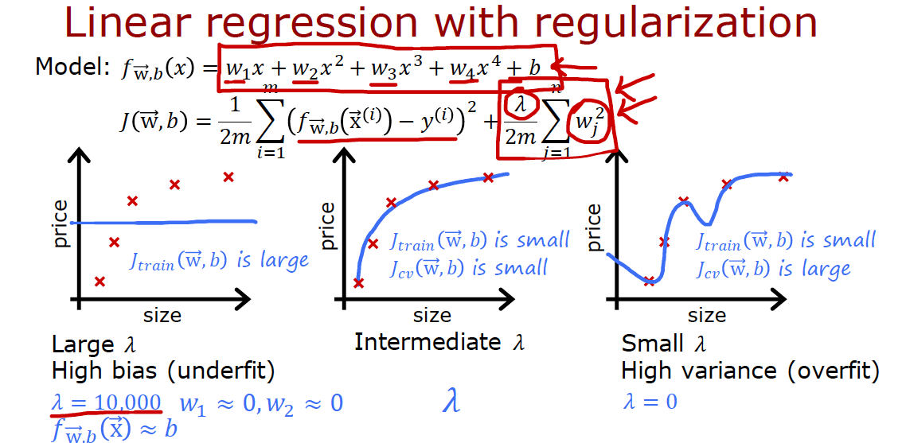
Bias and Variance

Slide 56
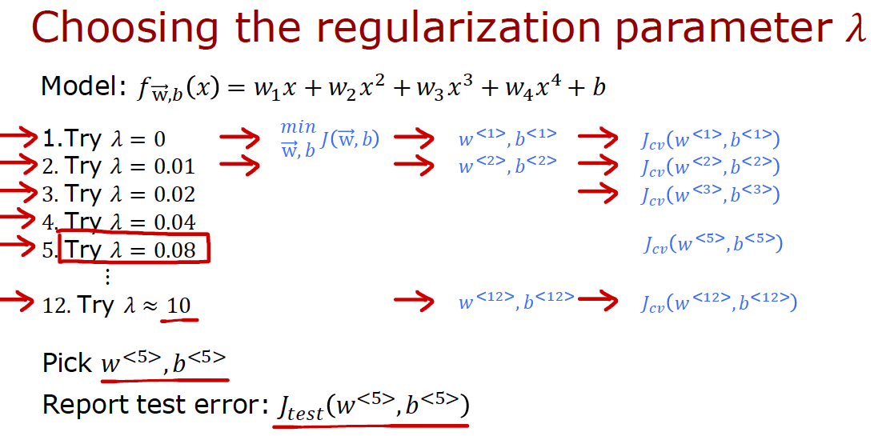
Bias and Variance

Slide 57
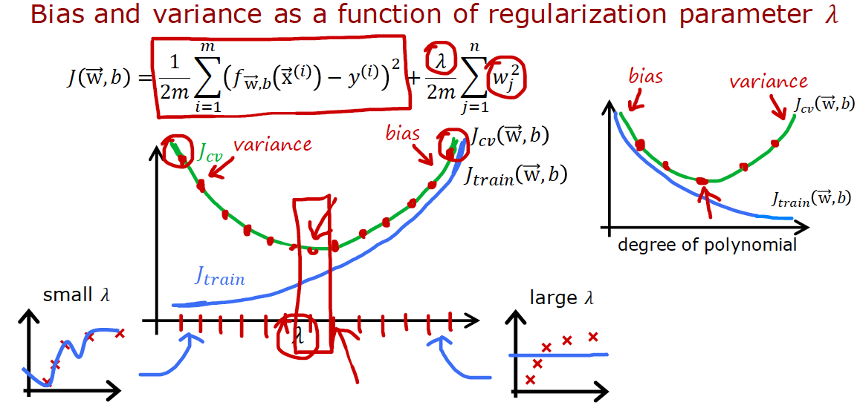
Bias and Variance

Slide 58
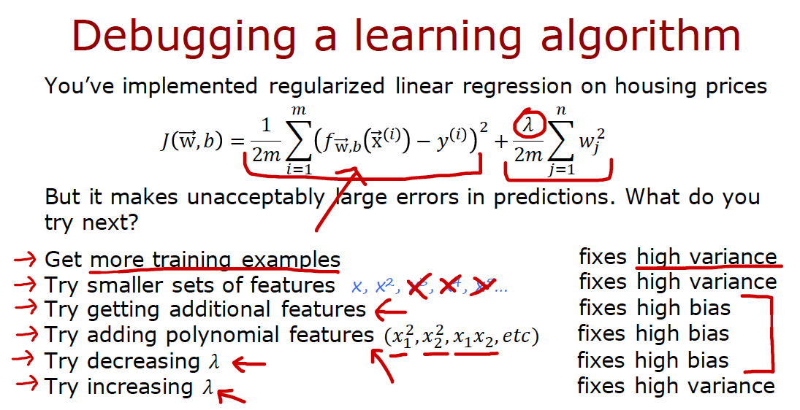
Bias and Variance

Slide 59
Multi Collinearity
When a dataset is having more features , it is possible that few of these features may be highly correlated
This leads to multi collinearity
Presence of this can destabilize the model
Multicollinearity arises when two variables that measure the same thing or similar things (e.g., weight and BMI) are both included in a multiple regression model; they will, in effect, cancel each other out and generally destroy your model.
Model building and diagnostics are tricky business!

Slide 61
Assumptions
Errors / residuals follow normal distribution
Homoscedasticity_ variance of error is constant
The error and independent variable are uncorrelated
Functional relationship between the outcome variable and feature is incorrectly defined

Slide 62
R Squared Error
Advertising (in lakhs of rupees) | Sales (in lakhs of rupees)
10 | 520
20 | 625
35 | 700
50 | 780
20 | 605

Slide 63
Thank You!
In our next session: Classification Models

